Slide 1
Lecture 12 Graphs
Exercises ANS
Department of Computer Science
Hofstra University
Acknowledgement: Lecture slides based on UofW Course on Data Structures

Slide 2
Q. Adjacency matrix and adjacency list
Write out the adjacency matrix and adjacency list for the directed graph.
C
B
F
G
D
A
E

Slide 3

Q. Adjacency matrix and adjacency list ANS
Write out the adjacency matrix and adjacency list for the directed graph.
 | A | B | C | D | E | F | G
A | 0 | 1 | 0 | 1 | 0 | 0 | 0
B | 0 | 0 | 1 | 0 | 0 | 0 | 0
C | 0 | 0 | 0 | 0 | 0 | 1 | 0
D | 0 | 1 | 0 | 0 | 1 | 1 | 0
E | 0 | 0 | 0 | 0 | 0 | 1 | 0
F | 0 | 0 | 0 | 0 | 0 | 0 | 0
G | 0 | 0 | 0 | 0 | 0 | 1 | 0
B, D
C
C
B
F
G
F
D
B, F, E
A
E
F
F

Slide 4
Q. Adjacency matrix and adjacency list
Write out the adjacency matrix and adjacency list for the undirected graph.
C
B
F
G
D
A
E

Slide 5
Q. Adjacency matrix and adjacency list ANS
Write out the adjacency matrix and adjacency list for the directed graph.
 | A | B | C | D | E | F | G
A | 0 | 1 | 0 | 1 | 0 | 0 | 0
B | 1 | 0 | 1 | 1 | 0 | 0 | 0
C | 0 | 1 | 0 | 0 | 0 | 1 | 0
D | 1 | 1 | 0 | 0 | 1 | 1 | 0
E | 0 | 0 | 0 | 1 | 0 | 1 | 0
F | 0 | 0 | 1 | 1 | 1 | 0 | 1
G | 0 | 0 | 0 | 0 | 0 | 1 | 0
C
B, D
A, C, D
B
F
G
B, F
D
A, B, E, F
A
E
D, F
C, D, E, G
F

Slide 6
Q: Graph Traversals (Pre-Order & Post-Order)
C
Give the DFS pre-order and post-order traversals of this directed graph, starting from node A. When there are muliple possible orders of visiting the next node, select the next node in alphabetical order.
DFS Pre-Order:
DFS Post-Order:
B
F
G
D
A
E
Stack:
You do NOT need to write out the stack or queue contents in the exam
6
Notes:
Dark blue: Most recently marked
Light blue: Node has been marked, in the middle of visiting its children
Green: Node has been marked and we’re finished visiting (have seen all children)

Slide 7
C
DFS Pre-Order:
A
DFS Post-Order:
B
F
G
D
A
E
Stack: A
7
Notes:
Dark blue: Most recently marked
Light blue: Node has been marked, in the middle of visiting its children
Green: Node has been marked and we’re finished visiting (have seen all children)

Slide 8
C
DFS Pre-Order:
A, B
DFS Post-Order:
B
F
G
D
A
E
Stack: A, B
8

Slide 9
C
DFS Pre-Order:
A, B, C
DFS Post-Order:
B
F
G
D
A
E
Stack: A, B, C
9

Slide 10
C
DFS Pre-Order:
A, B, C, F
DFS Post-Order:
B
F
G
D
A
E
Stack: A, B, C, F
10

Slide 11
C
DFS Pre-Order:
A, B, C, F
DFS Post-Order:
F
B
F
G
D
A
E
Stack: A, B, C
11

Slide 12
C
DFS Pre-Order:
A, B, C, F
DFS Post-Order:
F, C
B
F
G
D
A
E
Stack: A, B
12

Slide 13
C
DFS Pre-Order:
A, B, C, F
DFS Post-Order:
F, C, B
B
F
G
D
A
E
Stack: A
13

Slide 14
C
DFS Pre-Order:
A, B, C, F, D
DFS Post-Order:
F, C, B
B
F
G
D
A
E
Stack: A, D
14

Slide 15
C
DFS Pre-Order:
A, B, C, F, D, E
DFS Post-Order:
F, C, B,
B
F
G
D
A
E
Stack: A, D, E
15

Slide 16
C
DFS Pre-Order:
A, B, C, F, D, E
DFS Post-Order:
F, C, B, E
B
F
G
D
A
E
Stack: A, D
16

Slide 17
C
DFS Pre-Order:
A, B, C, F, D, E
DFS Post-Order:
F, C, B, E, D
B
F
G
D
A
E
Stack: A,
17

Slide 18
C
DFS Pre-Order:
A, B, C, F, D, E
DFS Post-Order:
F, C, B, E, D, A
B
F
G
D
A
E
Stack:

Slide 19
DFS Pre-Order:
A, B, C, F, D, E, G
DFS Post-Order:
F, C, B, E, D, A, G
Toplogical Sort (reverse of DFS Post-Order):
G, A, D, E, B, C, F
C
B
F
G
D
A
E
* After visiting F, restart on unmarked node G. G would be added to the stack (and forming the last element in both pre-order and post-order traversals)
Stack:
19

Slide 20
Q: Graph Traversals (BFS)
C
Give the BFS traversal of this directed graph, starting from node A. When there are muliple possible orders of visiting the next node, select the next node in alphabetical order.
BFS:
B
F
G
D
A
E
Queue: A
You do NOT need to write out the stack or queue contents in the exam
20
Notes:
Dark blue: Most recently marked
Light blue: Node has been marked, in the middle of visiting its children
Green: Node has been marked and we’re finished visiting (have seen all children)

Slide 21
C
BFS:
A
B
F
G
D
A
E
Queue: B D
21
Notes:
Dark blue: Most recently marked
Light blue: Node has been marked, in the middle of visiting its children
Green: Node has been marked and we’re finished visiting (have seen all children)

Slide 22
C
BFS:
A B
B
F
G
D
A
E
Queue: D C
22
Notes:
Dark blue: Most recently marked
Light blue: Node has been marked, in the middle of visiting its children
Green: Node has been marked and we’re finished visiting (have seen all children)

Slide 23
C
BFS:
A B D
B
F
G
D
A
E
Queue: C E F
23
Notes:
Dark blue: Most recently marked
Light blue: Node has been marked, in the middle of visiting its children
Green: Node has been marked and we’re finished visiting (have seen all children)

Slide 24
C
BFS:
A B D C
B
F
G
D
A
E
Queue: E F
24
Notes:
Dark blue: Most recently marked
Light blue: Node has been marked, in the middle of visiting its children
Green: Node has been marked and we’re finished visiting (have seen all children)

Slide 25
C
BFS:
A B D C E
B
F
G
D
A
E
Queue: F
Notes:
Dark blue: Most recently marked
Light blue: Node has been marked, in the middle of visiting its children
Green: Node has been marked and we’re finished visiting (have seen all children)

Slide 26
C
BFS:
A B D C E F
B
F
G
D
A
E
Queue:
26
Notes:
Dark blue: Most recently marked
Light blue: Node has been marked, in the middle of visiting its children
Green: Node has been marked and we’re finished visiting (have seen all children)

Slide 27
C
BFS:
A B D C E F
B
F
G
D
A
E
Queue: G
27
Notes:
Dark blue: Most recently marked
Light blue: Node has been marked, in the middle of visiting its children
Green: Node has been marked and we’re finished visiting (have seen all children)

Slide 28
Q: Graph Traversals (BFS) ANS
C
BFS:
A B D C E F G
B
F
G
D
A
E
Queue:
28
Notes:
Dark blue: Most recently marked
Light blue: Node has been marked, in the middle of visiting its children
Green: Node has been marked and we’re finished visiting (have seen all children)

Slide 29
Q. Topological Sort
Give the DFS pre-order and post-order traversals, and a topological sort of this directed graph for prerequisite courses, starting from node “enroll”.
123
373
417
enroll
416
415
126
390
Notes:
BFS can find shortest (unweighted) paths. DFS can detect cycles and create a Q. Topological Sort!
Give the depth-first search order (postorder) of the graph below.
Postorder. Add a vertex to a list after visiting all its outgoing neighbors.
Then, reverse the resulting order.

Slide 30
Q. Topological Sort
123
373
417
enroll
416
415
126
390
Pre-order
Visited
List
Post-order
Notes:
BFS can find shortest (unweighted) paths. DFS can detect cycles and create a Q. Topological Sort!

Slide 31
Q. Topological Sort
123
373
417
enroll
416
415
126
390
Pre-order
Visited | 123
List
Post-order
Notes:
BFS can find shortest (unweighted) paths. DFS can detect cycles and create a Q. Topological Sort!

Slide 32
Q. Topological Sort
123
373
417
enroll
416
415
126
390
Pre-order
Visited | 123 | 373
List
Post-order
Notes:
BFS can find shortest (unweighted) paths. DFS can detect cycles and create a Q. Topological Sort!

Slide 33
Q. Topological Sort
123
373
417
enroll
416
415
126
390
Pre-order
Visited | 123 | 373 | 417
List
Post-order
Notes:
BFS can find shortest (unweighted) paths. DFS can detect cycles and create a Q. Topological Sort!

Slide 34
Q. Topological Sort
Backtrack!!
123
373
417
enroll
416
415
126
390
Pre-order
Visited | 123 | 373 | 417
List | 417
Post-order
Notes:
BFS can find shortest (unweighted) paths. DFS can detect cycles and create a Q. Topological Sort!

Slide 35
Q. Topological Sort
123
373
417
enroll
416
415
126
390
Pre-order
Visited | 123 | 373 | 417 | 415
List | 417
Post-order
Notes:
BFS can find shortest (unweighted) paths. DFS can detect cycles and create a Q. Topological Sort!

Slide 36
Q. Topological Sort
123
373
417
Backtrack!!
enroll
416
415
126
390
Pre-order
Visited | 123 | 373 | 417 | 415
List | 417 | 415
Post-order
Notes:
BFS can find shortest (unweighted) paths. DFS can detect cycles and create a Q. Topological Sort!

Slide 37
Q. Topological Sort
Backtrack!!
123
373
417
enroll
416
415
126
390
Pre-order
Visited | 123 | 373 | 417 | 415
List | 417 | 415 | 373
Post-order
Notes:
BFS can find shortest (unweighted) paths. DFS can detect cycles and create a Q. Topological Sort!

Slide 38
Q. Topological Sort
123
373
417
enroll
416
415
126
390
Pre-order
Visited | 123 | 373 | 417 | 415 | 416
List | 417 | 415 | 373
Post-order
Notes:
BFS can find shortest (unweighted) paths. DFS can detect cycles and create a Q. Topological Sort!

Slide 39
Q. Topological Sort
123
373
417
Backtrack!!
enroll
416
415
126
390
Pre-order
Visited | 123 | 373 | 417 | 415 | 416
List | 417 | 415 | 373 | 416
Post-order
Notes:
BFS can find shortest (unweighted) paths. DFS can detect cycles and create a Q. Topological Sort!

Slide 40
Q. Topological Sort
Backtrack!!
123
373
417
enroll
416
415
126
390
Pre-order
Visited | 123 | 373 | 417 | 415 | 416
List | 417 | 415 | 373 | 416 | 123
Post-order
Notes:
BFS can find shortest (unweighted) paths. DFS can detect cycles and create a Q. Topological Sort!

Slide 41
Q. Topological Sort
123
373
417
enroll
416
415
126
390
Pre-order
Visited | 123 | 373 | 417 | 415 | 416 | 126
List | 417 | 415 | 373 | 416 | 123
Post-order
Notes:
BFS can find shortest (unweighted) paths. DFS can detect cycles and create a Q. Topological Sort!

Slide 42
Q. Topological Sort
123
373
417
enroll
416
415
126
390
Pre-order
Visited | 123 | 373 | 417 | 415 | 416 | 126 | 390
List | 417 | 415 | 373 | 416 | 123
Post-order
Notes:
BFS can find shortest (unweighted) paths. DFS can detect cycles and create a Q. Topological Sort!

Slide 43
Q. Topological Sort
123
373
417
enroll
416
415
Already visited!
126
390
Pre-order
Visited | 123 | 373 | 417 | 415 | 416 | 126 | 390
List | 417 | 415 | 373 | 416 | 123
Post-order
Notes:
BFS can find shortest (unweighted) paths. DFS can detect cycles and create a Q. Topological Sort!

Slide 44
Q. Topological Sort
123
373
417
enroll
416
415
Already visited!
126
390
Pre-order
Visited | 123 | 373 | 417 | 415 | 416 | 126 | 390
List | 417 | 415 | 373 | 416 | 123
Post-order
Notes:
BFS can find shortest (unweighted) paths. DFS can detect cycles and create a Q. Topological Sort!

Slide 45
Q. Topological Sort
123
373
417
enroll
416
415
126
390
Pre-order
Visited | 123 | 373 | 417 | 415 | 416 | 126 | 390
List | 417 | 415 | 373 | 416 | 123
Post-order
Notes:
BFS can find shortest (unweighted) paths. DFS can detect cycles and create a Q. Topological Sort!

Slide 46
Q. Topological Sort
123
373
417
enroll
416
415
Backtrack!!
126
390
Pre-order
Visited | 123 | 373 | 417 | 415 | 416 | 126 | 390
List | 417 | 415 | 373 | 416 | 123 | 390
Post-order
Notes:
BFS can find shortest (unweighted) paths. DFS can detect cycles and create a Q. Topological Sort!

Slide 47
Q. Topological Sort
123
373
417
enroll
416
415
Backtrack!!
126
390
Pre-order
Visited | 123 | 373 | 417 | 415 | 416 | 126 | 390
List | 417 | 415 | 373 | 416 | 123 | 390 | 126
Post-order
Notes:
BFS can find shortest (unweighted) paths. DFS can detect cycles and create a Q. Topological Sort!

Slide 48
Q. Topological Sort
123
373
417
enroll
416
415
126
390
Pre-order
Visited | 123 | 373 | 417 | 415 | 416 | 126 | 390
List | 417 | 415 | 373 | 416 | 123 | 390 | 126
Post-order
Notes:
BFS can find shortest (unweighted) paths. DFS can detect cycles and create a Q. Topological Sort!

Slide 49
Q. Topological Sort Final ANS
123
373
417
Topological order
[enroll, 126, 390, 123, 416, 373, 415, 417]
(Initial node “enroll” is omitted from the table, but you can also add it)
enroll
416
415
126
390
Pre-order
Visited | 123 | 373 | 417 | 415 | 416 | 126 | 390
List | 417 | 415 | 373 | 416 | 123 | 390 | 126
Post-order
Notes:
BFS can find shortest (unweighted) paths. DFS can detect cycles and create a Q. Topological Sort!

Slide 50
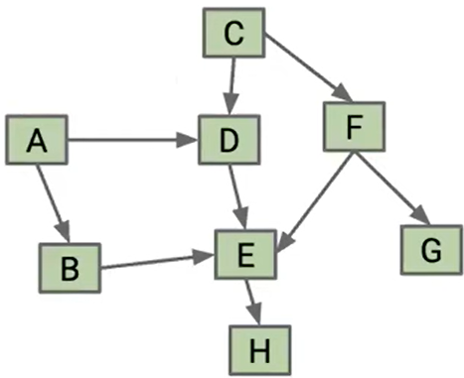
Q. Graph Traversal (Directed Graph)
Give the BFS, DFS pre-order and post-order traversals, and a topological sort of this directed graph, starting from either A or C. When there are muliple possible orders of visiting the next node, select the next node in alphabetical order.
50
Notes:
Pre-order traversal is (A, B, E, H, D, C, F, G)
Post-order traversal is (H, E, B, D, A, G, F, C)
Topological Sort is (C, F, G, A, D, B, E, H)
Pre-order traversal is (C, D, E, H, F, G, A, B)
Post-order traversal is (H, E, D, G, F, C, B, A)
Topological Sort is (A, B, C, F, G, D, E, H)

Slide 51
Q. Graph Traversal (Directed Graph) ANS
Starting from node A:
Pre-order traversal: (A, B, E, H, D, C, F, G)
Post-order traversal: (H, E, B, D, A, G, F, C)
Topological Sort: (C, F, G, A, D, B, E, H)
BFS: (A, B, D, E, H, C, F, G)
Starting from node C, ‘
Pre-order traversal: (C, D, E, H, F, G, A, B)
Post-order traversal: (H, E, B, D, A, G, F, C)
Topological Sort: (C, F, G, A, D, B, E, H)
BFS: (C, D, F, E, G, H, A, B)
51
Notes:
Pre-order traversal is (A, B, E, H, D, C, F, G)
Post-order traversal is (H, E, B, D, A, G, F, C)
Topological Sort is (C, F, G, A, D, B, E, H)
C, D, E, H, F, G, A, B

Slide 52
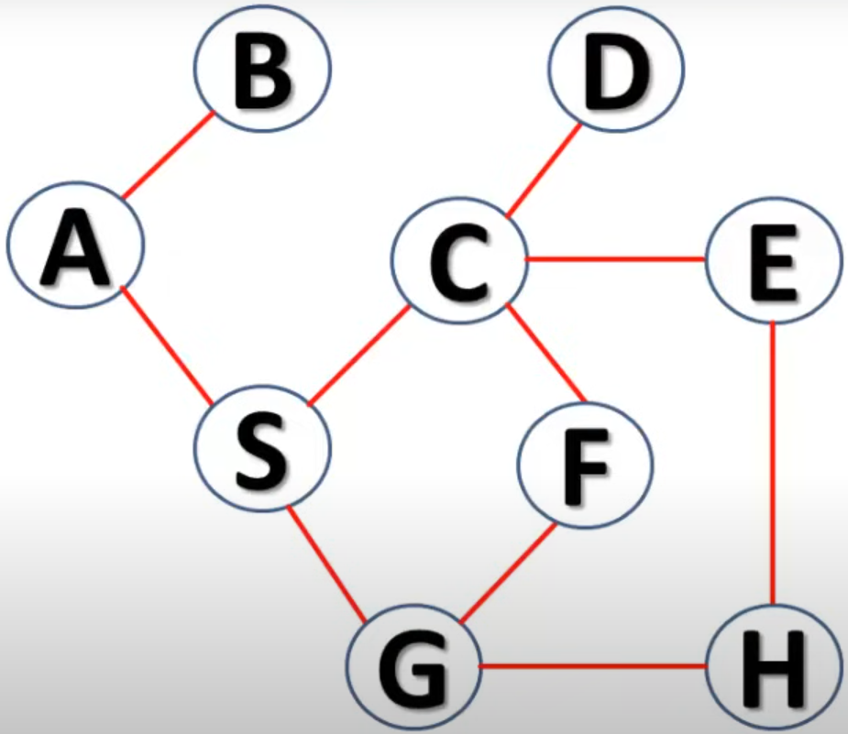
Q. Graph Traversal (Undirected Graph)
Give the BFS, DFS pre-order and post-order traversals of this undirected graph, starting from either A. When there are muliple possible orders of visiting the next node, select the next node in alphabetical order.

Slide 53
Q. Graph Traversal (Undirected Graph) ANS
Starting from node A:
Pre-order traversal: A B S C D E H G F
Post-order traversal: B D F G H E C S A
BFS: A B S C G D E F H
(Topological Sort: N/A, since it is only for DAG)
Depth First Search Algorithm, Go GATE IIT
https://www.youtube.com/watch?v=iaBEKo5sM7w
The video illustrates pre-order traversal with a stack. The post-order traversal is obtained in the order that the nodes are popped off the stack, (c.f., Slide 29 “DFS Traversals and Topological Sort” in Lecture 12-graphs.pdf)
Notes:
A B S C D E H G F
B, D, F, G, H, E, C, S, A
B, D, F, G, H, E, C, S, A

Slide 54
Q. Graph Traversal (Undirected Graph)
Give the BFS, DFS pre-order and post-order traversals of this undirected graph, starting from A. When there are muliple possible orders of visiting the next node, select the next node in alphabetical order.
B
F
A
C
E
D
H
G
Notes:
The text in the image is:
A B S C D E H G F
Add to follow-up
Check sources
Citations:
https://pplx-res.cloudinary.com/image/upload/v1744761514/user_uploads/qreQCTCmGSVFnDV/image.jpg
Answer from Perplexity: pplx.ai/share

Slide 55
Q. Graph Traversal (Undirected Graph)
Starting from node A:
Pre-order traversal: A B E G F C H D
Post-order traversal: G E B H C F D A
BFS: A B D G E F C H
(Topological Sort: N/A, since it is only for DAG)
Graph Traversals - Breadth First and Depth First
https://www.youtube.com/watch?v=bIA8HEEUxZI
B
F
A
C
E
D
H
G
Notes:
The text in the image is:
A B S C D E H G F
Add to follow-up
Check sources
Citations:
https://pplx-res.cloudinary.com/image/upload/v1744761514/user_uploads/qreQCTCmGSVFnDV/image.jpg
Answer from Perplexity: pplx.ai/share

